Slide 1
Object Oriented Design & Programming
Unit-5
Operator overloading
OODP

Slide 2
🞄 Operator overloading is one of the striking features of C++ language. It is an important technique that has enhanced the power of extensibility of C++.
Operator Overloading
🞄 C++ tries to make user defined data types behave in much the same way as the built in types. For instance, C++ permits us to add two variables of user defined types with the same syntax that is applied to the basic types.
🞄 This means that C++ had the ability to provide the operators with a special meaning for a data type. The mechanism of giving such special meaning to operator is known as operator overloading.

Slide 3
🞄 We can overload all the operators except following:
🞄 Member access operators( . , .*)
🞄 Scope resolution operator( :: )
🞄 Size operator(sizeof)
Operators that cannot be overloaded
🞄 Conditional operator(?:)
🞄 Semantics of an operator can be extended
🞄 We cannot change its syntax, the grammatical rules that govern its use such as the number of operands, precedence and associativity.
🞄 When operator is overloaded, its original meaning is not lost.
🞄 Operator overloading is also called compile time polymorphism.

Slide 4
🞄 This is done with help of a special function, called operator
🞄 To define an additional task to an operator, we must specify what it means in relation to the class to which the operator is applied.
function.
return type class-name :: operator op(arg list)
{
Function body //task defined
}
🞄 Return type is type of value returned by the specified operation.
🞄 Op is the operator being overloaded.
🞄 Operator is keyword.
Defining Operator Overloading

Slide 5
🞄 Operator function must be either member functions (non static) or friend functions.
🞄 A basic difference between them is:
A friend function will have only one argument for unary operators and two for binary operators.
While a member has no arguments for unary operators and only
one for binary operators.
🞄 This is because the object used to invoke the member function is passed implicitly and therefore is available for the member function. This is not the case with friend functions. Arguments may be passed either by value or by reference.
🞄 Operator functions are declared in the class using operator.
Operator Function

Slide 6
Operator function
vector operator+(vector) | Vector addition
vector operator-() | Unary minus
friend vector operator+(vector, vector) | Vector addition
friend vector operator-(vector) | Unary minus
vector operator-(vector &) | Subtraction
int operator==(vector) | Comparison
friend int operator==(vector, vector) | Comparison
🞄 vector is a data type of class

Slide 7
🞄 The process of overloading involves the following steps:
Create a class that defines the data type that is to be used in the overloading operation
Declare the operator function operator op( ) in the public part of the class. It may be either a member function or a friend function
Define the operator function to implement the required operator
Steps for Operator overloading

Slide 8
op x OR x op
🞄 Unary operator functions can be invoked as
🞄 Binary operator function can be invoked as
x op y
🞄 op x (or x op) would be interpreted as operator op(x) for friend
function.
🞄 Similarly, the expression x op y can be interpreted as
🞄 x.operator op(y) in the case of member functions.
OR
🞄 Operator op(x, y) in case of friend functions .
How to call ?

Slide 9
🞄 Example: Unary minus operator
🞄 A minus operator when used as a unary, takes just one operand.
🞄 This operator changes the sign of an operand when applied to a basic data item.
🞄 How to overload this operator so that it can be applied to an object in much the same way as is applied to an int or float variable.
🞄 The unary minus when applied to an object should change the sign
of each of its data items.
Overloading Unary Operators

Slide 10
class space
{
int x, y, z;
public:
void getdata (int a, int b, int c); void display(void);
void operator-();
//overload unary minus
};
void space::getdata(int a, int b, int c)
{
x = a; y = b; z = c;
}
void space :: display(void)
{
cout <<x<<" "<<y<<" "<<z<< endl ;
}
void space :: operator-()
{
x = -x;
y = -y;
z = -z;
}
int main()
{
space S; S.getdata(10, 20, 30); cout<<"S :";
S.display();
// activates operator-() function
-S;
cout<<"S :";
S.display(); return 0;
}
Overloading Unary Minus Operators

Slide 11
🞄 because, the function operator-() does not return any value. It can
🞄 S2 = -S1; //will not work.
work if the function is modified to return an object.
🞄 It is possible to overload a unary minus operator using a friend function as follows:
Overloading Unary Minus Operators
friend void operator-(space &s);
//declaration
void operator-(space &s)
{
s.x= -s.x;
s.y= -s.y;
s.z= -s.z;
}
//definition

Slide 12
🞄 Time T1 = 1 hour 45 minutes
🞄 Time T2 = 2 hour 45 minutes
🞄 Time T3 = sum(T1, T2)
//through friend function
Overloading Binary Operators
🞄 Time T3 = T1+T2
//through operator overloading
🞄 We should note the following features of this function:
It receives only one time1 type argument explicitly.
It returns a time1 type value.
It is a member function of time1.

Slide 13
class time1
{
int hours, minutes;
public: time1()
{
}
time1(int h, int m)
{
hours = h; minutes = m;
}
void puttime()
{
cout<<hours<<" hours and "; cout<<minutes<<" minutes \n";
}
time1 operator+(time1);
};
time1 time1 :: operator+(time1 t1)
{
time1 t3;
t3. minutes = t1.minutes+minutes; t3. hours = t3.minutes/60; t3.minutes = t3.minutes%60; t3.hours += t1.hours+hours;
return t3;
}
int main()
{
time1 T1, T2, T3; T1 = time1(1,45); T2 = time1(2,45); T3 = T1+T2;
T3.puttime(); return 0;
}
Overloading Binary Operators Example

Slide 14
🞄 T3 = T1+ T2; // invokes operator+() function
🞄 Here T1, T2, T3 are the object of class time1.
🞄 The function is expected to add two time1 values and return a
time1 value as the result.
🞄 But receives only one value as argument. Where does the other value come from?
🞄 A member function can be invoked only by an object of the same
class.
🞄 Here, the object T1 takes the responsibility of invoking the function and T2 plays the role of an argument that is passed to the function. The above invocation statement is equivalent to
🞄 T3 = T1.operator+(T2); // usual function call syntax
Overloading Binary Operators

Slide 15
🞄 T3 = T1+ T2;
// invokes operator+() function
Overloading Binary Operators
🞄 equivalents to
🞄 T3 = T1.operator+(T2);
// usual function call syntax
🞄 A rule in overloading of binary operators:
🞄 The left-hand operand is used to invoke the operator function
🞄 And the right-hand operand is passed as an argument

Slide 16
🞄 As stated earlier, friend function may be used in the place of member functions for overloading a binary operator, the only difference being that a friend function requires two arguments to be explicitly passed to it, while a member function requires only one.
Overloading binary operator using friend function
🞄 The previous program can be modified using a friend operator function.

Slide 17
🞄 In previous program, we overloaded the + operator through member function.
🞄 We can do this also through friend function as given below:
friend time1 operator+(time1, time1); time1 operator+(time1 t1, time1 t2)
{
time1 t3;
t3.minutes = t1.minutes+t2.minutes; t3.hours = t3.minutes/60;
t3.minutes = t3.minutes%60; t3.hours += t1.hours+t2.hours; return t3;
}
//declaration
//definition
Overloading Binary Operator (+) using friend function
In this case, the statement
T3 = Tl + T2;
is equivalent to
T3 = operator+(Tl, T2);

Slide 18
🞄 In most cases, we will get the same results by the use of either a friend function or a member function. Why then an alternative is made available?
🞄 There are certain situations where we would like to use a friend function rather than a member function.
🞄 For instance, consider a situation where we need to use two different types of operands for a binary operator, say, one an object and another built in type data as shown below,
🞄 A = B+2;
OR
🞄 A = B*2;
🞄 Where A and B are objects of the same class This will work for a
member function.
What to use ?

Slide 19
🞄 But, the statement A = 2 + B OR A = 2*B Will not work.
🞄 Because the left hand operand which is responsible for invoking the member function would be an object of the same class.
However friend function allows both approaches.
What to use ?
🞄 It may be recalled that an object is not needed to invoke a friend function but can be passed as an argument. Thus, we can use a friend function with a built in type data as the left hand operand and an object as the right hand operand.

Slide 20
🞄 There are no operators for manipulating the strings. One of the main drawbacks of string manipulations in C is that whenever a string is to be copied, the programmer must first determine its length and allocate the required amount of memory.
Manipulation of Strings using operators
🞄 Although these limitations exist in C++ as well, it permits us to create our own definitions of operators that can be used to manipulate the strings very much similar to the decimal numbers.

Slide 21
class string1
{
char *p; int len;
public: string1()
{
len=0; p=0;
}
//create null string
Example
string1(const char *s); //create string from array string1(const string1 &s); //copy constructor
~string1()
{
delete p;
}
friend string1 operator+(const string1 &s, const string1 &t); //+ operator friend int operator<=(const string1 &s, const string1 &t); //<= operator friend void show(const string1 s);
};

Slide 22
string1 :: string1(const char *s)
{
len=strlen(s); p=new char[len+1]; strcpy(p, s);
}
string1 :: string1(const string1 &s)
{
len=s.len;
p=new char[len+1];
strcpy(p,s.p);
}
//overloading + operator
string1 operator+(const string1 &s, const string1 &t)
{
string1 temp; temp.len = s.len +t.len;
temp.p=new char[temp.len+1]; strcpy(temp.p, s.p);
strcat(temp.p, t.p); return(temp);
}
Example

Slide 23
//overloading <= operator
int operator<=(const string1 &s, const string1 &t)
{
int m=strlen(s.p); int n=strlen(t.p); if(m<=n)
return (1); else
return (0);
}
void show(const string1 s)
{
cout<<s.p;
}
Example

Slide 24
int main()
{
string1 s1="New"; string1 s2="York"; string1 s3=" Delhi";
//string1 t1,t2,t3; string1 t1 = s1; string1 t2 = s2; string1 t3 = s1+s3;
cout<<"\nt1= "; show(t1); cout<<"\nt2= "; show(t2); cout<<"\nt3= "; show(t3);
cout<<"\n";
if(t1<=t3)
{
show(t1);
cout<<" Smaller than "; show(t3);
}
else
{
show(t3);
cout<<" Smaller than "; show(t1);
}
}
Example

Slide 25
1. Only existing operators can be overloaded. New operators
🞄 Although it looks simple to redefine the operators, there are certain restrictions and limitations in overloading them Some of them are listed below:
cannot be created
The overloaded operator must have at least one operand that is of user defined type.
We cannot change the basic meaning of an operator. That is to say, we cannot redefine the plus(+) operator to subtract one value from the other.
Overloaded operators follow the syntax rules of the original operators. They cannot be overridden.
We cannot use friend functions to overload certain operators. However, member functions can be used to overload them. (=, (), [ ], ->)
Rules / Pitfalls of overloading Operators

Slide 26
7. Following operators cannot be overloaded ( ., .*, ::, sizeof, ?:)
6. Unary operators, overloaded by means of a member function, take no explicit arguments and return no explicit values, but those overloaded by means of a friend, take one reference argument (the object of the relevant class).
Rules for overloading Operators
Binary operators overloaded through a member function take one explicit argument and those which are overloaded through a friend function take two explicit arguments.
When using binary operator overloaded through a member function, the left hand operand must be an object of the relevant class.
10. Binary arithmetic operators such as must explicitly return a value.
They must not attempt to change their own arguments.

Slide 27
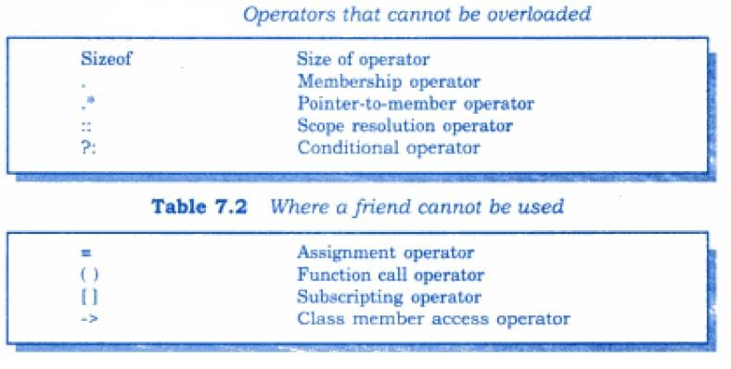
Operators can not be overloaded

Slide 28
🞄 We know that when constants and variables of different types are mixed in an expression, C/C++ applies automatic type conversion to the operands as per certain rules. This is for basic data types.
🞄 Similarly, an assignment operation also causes the automatic type conversion. The type of data to the right of an assignment operator is automatically converted to the type of the variable on the left. For Example,
int m;
float x = 3.14159; m = x;
🞄 convert x to integer before assignment. Thus, the fractional part is truncated.
Type Conversion

Slide 29
🞄 The compiler is unknown about the user defined data types and
about their conversions to other data types.
🞄 The programmer should write the code that convert basic data type to user defined and visa versa. Three situations for incompatible matches:
Type Conversion
From built in type to a class type
From class type to built in type
From one class type to another class type

Slide 30
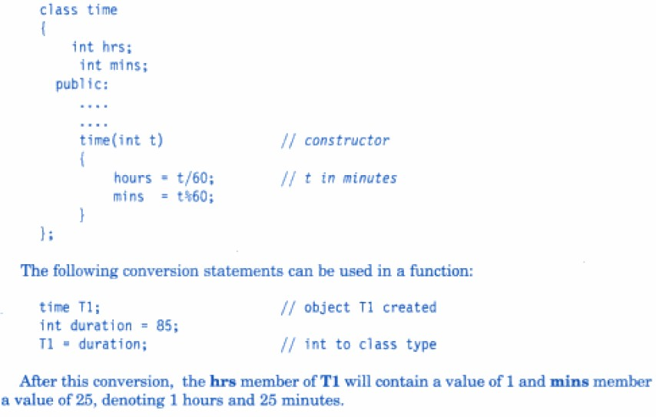
Built-in to class type

Slide 31
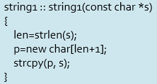
🞄 Constructors perform type conversion from the argument’s type to the constructor’s class type.
🞄 Constructors to convert from basic types to class types are quite common.
🞄 The constructors used for the type conversion take a single
argument whose type is to be converted.
🞄 In above example, left-hand operand of = operator is always a class object.
🞄 Therefore, we can also accomplish this conversion using an
overloaded = operator.
Built-in to class type
Here, the conversion is from char* type to string1 type.

Slide 32
🞄 Constructor does not support conversion from a class to basic type.
🞄 But, C++ allows us to define an overloaded casting operator that could be used to convert a class type data to a basic type.
🞄 The general form of an overloaded casting operator function usually
referred to as a conversion function.
operator type_name( )
{
………..
Function statements;
……….
}
🞄 Example:
🞄 The operator double() converts a class object to type double.
🞄 The operator int( ) converts a class type object to type int, and so on.
Class to Built- in Type conversion

Slide 33

vector:: operator double()
{
double sum = 0; for(int i =0; i<size ; i++)
sum= sum+ v[i] * v[i]; return sqrt(sum);
}
Class to Built- in Type conversion
🞄 This function converts a vector to the corresponding scalar magnitude. [Magnitude of a vector is square root of the sum of the squares of its components.]
🞄 The operator double() can be used as follows:
double length = double(V1);
or
double length = V1;
// V1 is object of type vector
🞄 Here, V1 is object of type vector. Both these statements have exactly the same effect.

Slide 34
🞄 When the compiler encounters a statement that requires the conversion of a class type to a basic type, it quietly calls the casting operator function to do the job.
🞄 The casting operator function should satisfy the following conditions :
It must be a member of class
It must not specify the return type
It must not have any arguments
Class to Built- in Type conversion
🞄 Since it is a member function, it is invoked by the object and therefore, the values used for conversion inside the functions belongs to the object that invoked a function. That is why function do not need any argument.
string1 :: operator char*( )
{
return (p);
}
string1 :: operator int( )
{
return (len);
}
This is how we can write the functions for our previous example

Slide 35
objX= objY;
//objects of different types
Where:
objX----object of class X objY-----object of class Y.
One Class to another class type
🞄 The class Y type data is converted to the class X type data and the converted value is assigned to the objX. Since the conversion takes place from class Y to class X, Y is known as the source class and X is known as the destination class.
🞄 Such conversions between object of different classes can be
carried out by either a constructor or a conversion function.
🞄 How to decide which form to use?

Slide 36
Example
class invent2; class invent1 //source class { int code; // item code int items; // no. of items float price; //cost of each item public: invent1(int a, int b, float c) { code=a; items=b; price=c; } void putdata() { cout<<"Code:"<<code<<endl; cout<<"Item:"<<items<<endl; cout<<"Price:"<<price<<endl; } int getcode() { return code; } | int getitems() { return items; } float getprice() { return price; } //Class to basic type conversion operator float() { return(items * price); } //class to class type conversion (invent1 to invent2) /*operator invent2() { invent2 temp; temp.code=code; temp.value=price*items; return (temp); } */ };

Slide 37
Example
class invent2 //destination class { int code; // item code float value; //Total cost public: invent2() { code=0; value=0; } invent2(int x, float y) { code=x; value=y; } void putdata() { cout<<"Code:"<<code<<endl; cout<<"Value:"<<value<<endl; } | //constructor for conversion from invent1 to invent2 invent2(invent1 p) { code=p.getcode(); value=p.getitems() * p.getprice(); } }; int main() { invent1 s1(100,5,140.0); invent2 d1; float total_value; total_value = s1; d1=s1; cout<<"Product details invent1 type: \n“; s1.putdata(); cout<<"Stock value"<<endl; cout<<"Value="<<total_value<<endl; cout<<"Product details Invent2:"<<endl; d1.putdata(); return 0; }

Slide 38
🞄 Conversion function:
🞄 In conversion function, typename may be built in type or user
defined type.
🞄 In case of conversion between classes, typename refers to destination class name.
🞄 Therefore, when class need to be converted, casting operator function can be used (Source class).
🞄 So, the conversion takes place in the source class and result is given to the destination class object.
🞄 Constructor:
🞄 Constructor argument belongs to a source class and it passes to a
destination class for conversion.
🞄 So, conversion constructor placed in destination class.
One Class to another class type

Slide 39
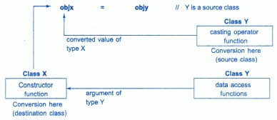
One Class to another class type

Slide 40
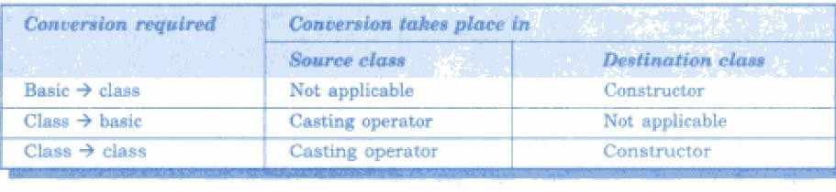
One Class to another class type
🞄 Note: We can use both approaches (constructor and the casting operator) for one class type to another class type conversion. But use only one at one time, don’t use both at the same time for class-to-class type conversion, since this introduces an ambiguity as to how that conversion should be performed.

Slide 41
Thank you

